Slide 1
Investigation of Saudi Arabia COVID-19 Cases (Oct 2020 - Oct 2021)
Sara N. Alfaraj
Oct 2021

Slide 2


Outline
Problem Questions
Data Collection
Exploratory Data Analysis
Molding
Analysis and Evaluation
Findings and Summery

Slide 3
Investigation Questions
Notes:
Data Collection
Data Preparation
Train Model on Data
Analysis and Evaluation
Conclusion

Slide 4

Investigation Questions
1
2
3
Are the different seasons and events affect the number of COVID-19 cases?
Do the numbers of COVID-19 cases differ between big/main cities and small cities?
Is the COVID-19 cases indicators expected to rise again after returning back to school?

Slide 5
Data Collection

Slide 6


Data Collection (Source)

Slide 7
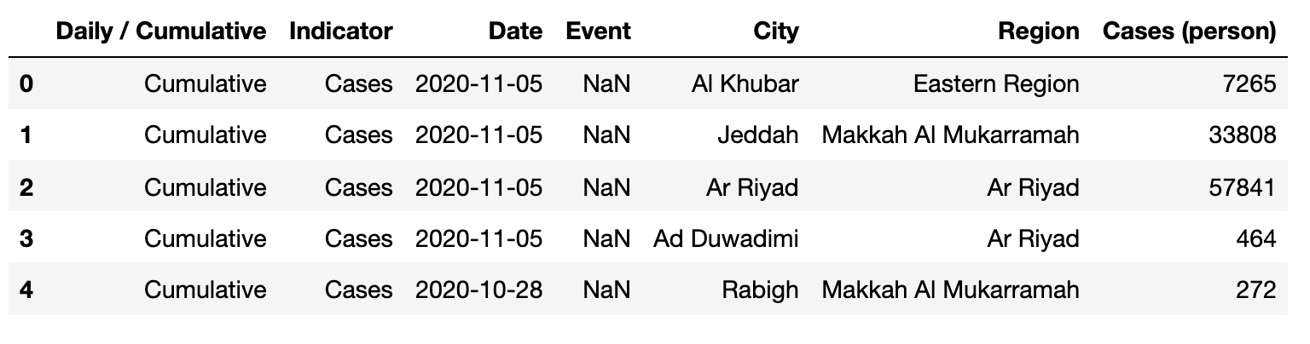
Data Collection (Features)
(428346X 7)

Slide 8
Exploratory Data Analysis

Slide 9

Exploratory Data Analysis
1
2
3
4
Distinguishes Attributes
Detect Outliers and Missing Values
Feature Engineering
Features Analysis
(visual)

Slide 10
Exploratory Data Analysis
428346 rows × 7 columns
1
Distinguishes Attributes
cumulative
Daily
Misleading
Informative
333140 rows × 7 columns
95206 rows × 7 columns

Slide 11
Exploratory Data Analysis
Filling the NaN values in 'Event'
2
Handel rows that have "Total" value in 'Region' and 'city' columns
Detect Outliers and Missing Values
Handel rows that have "Tested" and “Cases’ value in 'Indicator' column

Slide 12
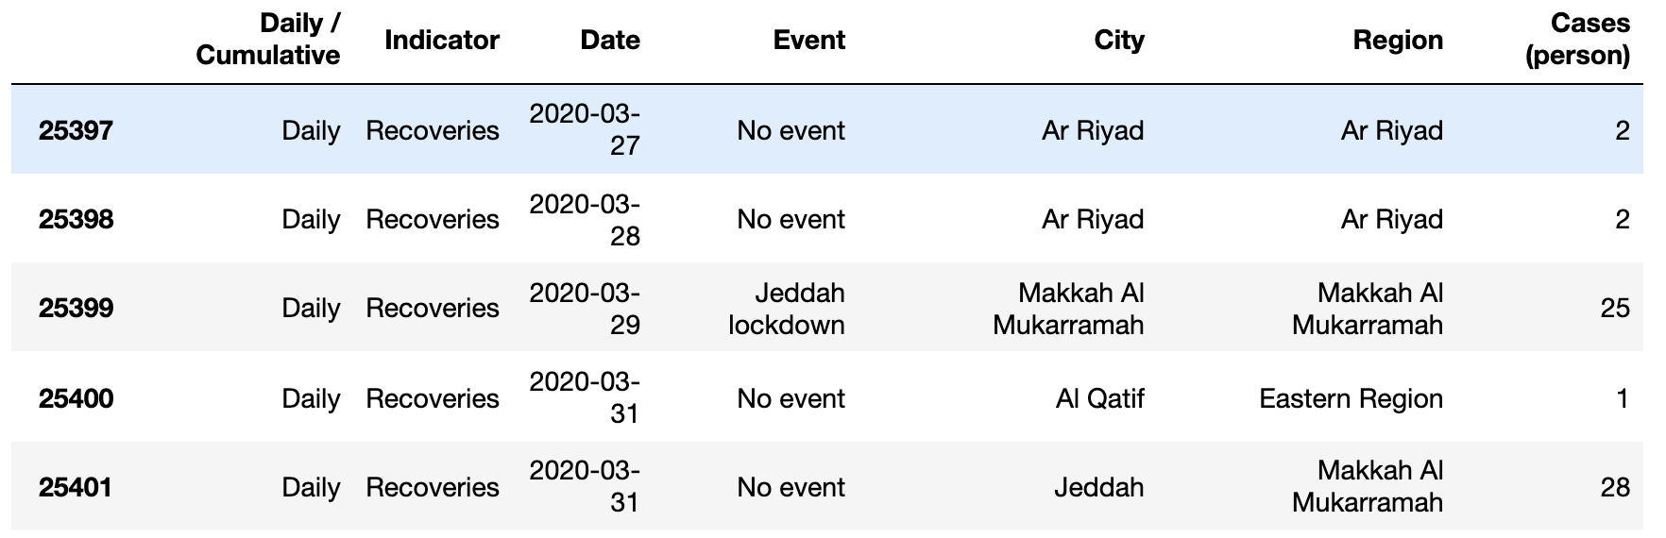
Data Collection (Features)
48292X 7

Slide 13
Convert 'Data' type
Exploratory Data Analysis
Add 'Day_name’ ,'Day','year' and 'month' columns
3
Rename 'Cases (person)' column
Feature Engineering
Rearrange Features
Converting categorical features to binary dummy variables
Standardize features by removing the mean and scaling to unit variance.

Slide 14
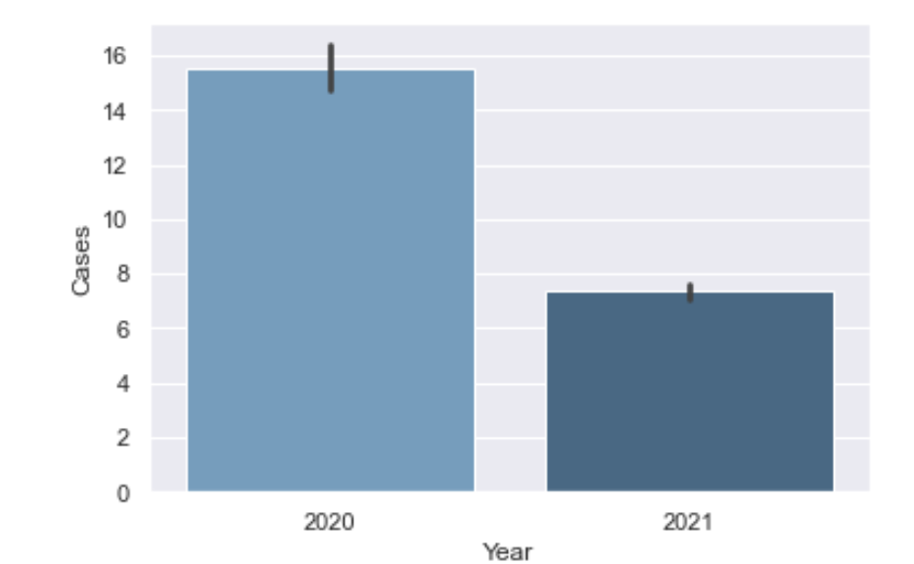
Features Analysis
Count of cases per year
4

Slide 15
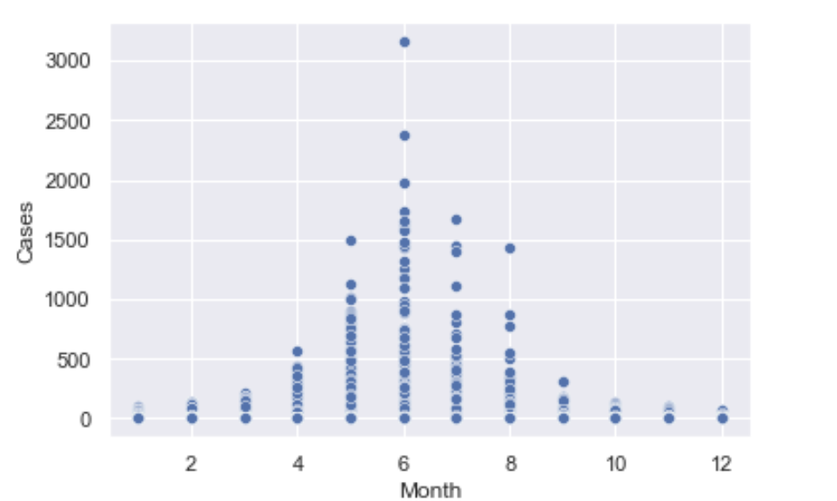
Features Analysis
Average of cases per months
4

Slide 16
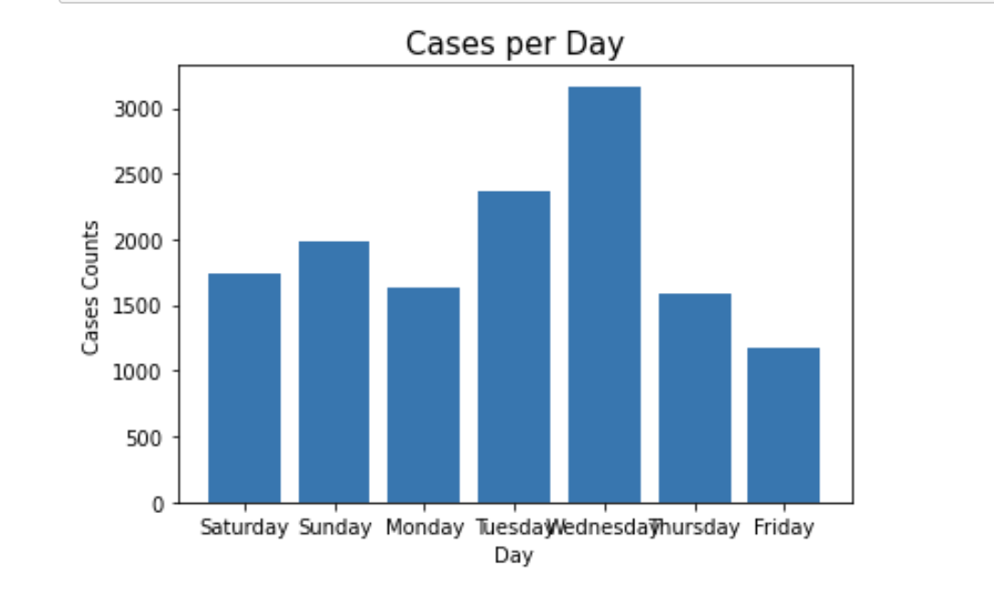
Features Analysis
Count of cases per day
4

Slide 17
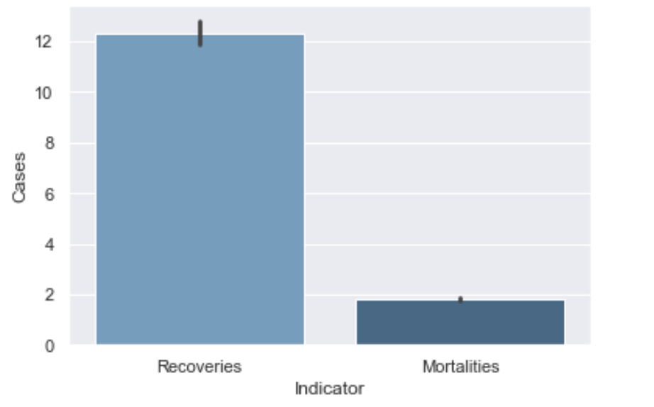
Features Analysis
Count of cases per indicator
4

Slide 18
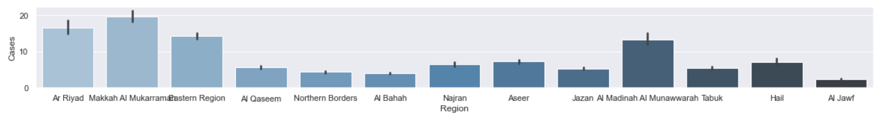
Features Analysis
Average of cases per region
4

Slide 19
Features Analysis
Average of cases per city
4

Slide 20
Modeling

Slide 21




Modeling
Data Encoding
Data Splitting (Training/Testing)
Model Building

Slide 22
Modeling
Feature variable (input)
month, day , year , City
Target variable (Output)
Cases
80% training
20% testing
K-fold
Logistic Regression

Slide 23
Analysis and Evaluation

Slide 24

Analysis and Evaluation
Accuracy
Recall score
0.004
0.36
Precision score
F1 score
0.001
0.002

Slide 25
Findings
Notes:
Data Collection
Data Preparation
Train Model on Data
Analysis and Evaluation
Conclusion

Slide 26
Thank You ☺

